Slide 1
HTML5

Slide 2
Goal
Add modern HTML features to your excisiting basic HTML skills

Slide 3
Agenda
Compatibility
New vs Old elements
Forms
Audio and Video
Canvas

Slide 4
Compatibility
Support everything that exists
Degrade gracefully
A datalist can also be a normal select
Don’t reinvent the wheel
Support what already exists
<br> or <br/> is allowed

Slide 5
HTML5
Shorthand syntax

Slide 6
Classic
<!DOCTYPE html PUBLIC
"-//W3C//DTD XHTML 1.0 Transitional//EN"
"http://www.w3.org/TR/xhtml1/DTD/xhtml1-transitional.dtd">
<html xmlns="http://www.w3.org/1999/xhtml" lang="en" xml:lang="en">
<head>
<meta http-equiv="Content-Type" content="text/html; charset=utf-8" />
<link rel="stylesheet" type="text/css" href="styles.css" />
<title></title>
</head>
<body>
<p>Hello World!</p>
</body>
</html>

Slide 7
DocType
<!DOCTYPE html PUBLIC>
<html xmlns="http://www.w3.org/1999/xhtml" lang="en" xml:lang="en">
<head>
<meta http-equiv="Content-Type" content="text/html; charset=utf-8" />
<link rel="stylesheet" type="text/css" href="styles.css" />
<title></title>
</head>
<body>
<p>Hello World!</p>
</body>
</html>

Slide 8
xmlns
<!DOCTYPE html PUBLIC>
<html lang="en" xml:lang="en">
<head>
<meta http-equiv="Content-Type" content="text/html; charset=utf-8" />
<link rel="stylesheet" type="text/css" href="styles.css" />
<title></title>
</head>
<body>
<p>Hello World!</p>
</body>
</html>

Slide 9
charset
<!DOCTYPE html PUBLIC>
<html xmlns="http://www.w3.org/1999/xhtml" lang="en" xml:lang="en">
<head>
<meta charset="utf-8" />
<link rel="stylesheet" type="text/css" href="styles.css" />
<title></title>
</head>
<body>
<p>Hello World!</p>
</body>
</html>

Slide 10
HTML5
New elements and attributes

Slide 11
New Elements
article
aside
audio
canvas
command
datalist
details
embed
figcaption
figure
footer
header
hgroup
keygen
mark
meter
nav
output
progress
rp
rt
ruby
section
source
summary
time
video
wbr
bdi
track
...

Slide 12

Question
WHERE DO THESE ELEMENTS COME FROM?

Slide 13
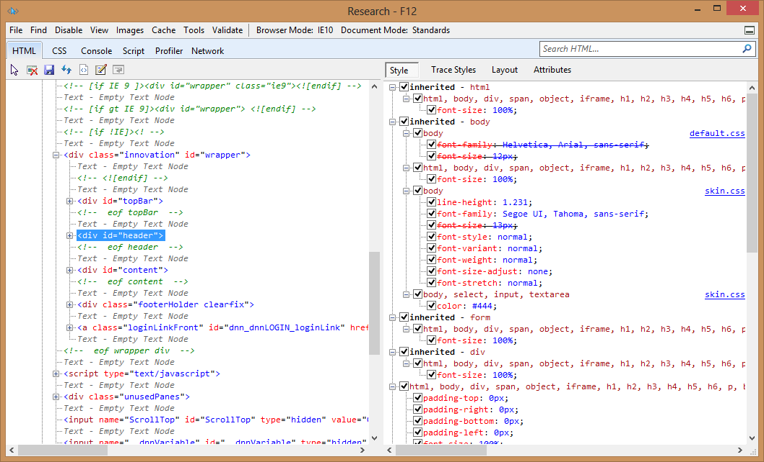

Slide 14
footer
menu
title
small
text
content
header
nav
copyright
button
main
search
msonormal
date
smalltext
body
style1
top
white
link

Slide 15
What if a browser doesn’t support these elements
Every browser has a list of elements they support
Firefox: list of elements
Each browser has its own list ☹
Use a reset.css or normalize.css

Slide 16
HTML5
Obsolete Elements

Slide 17
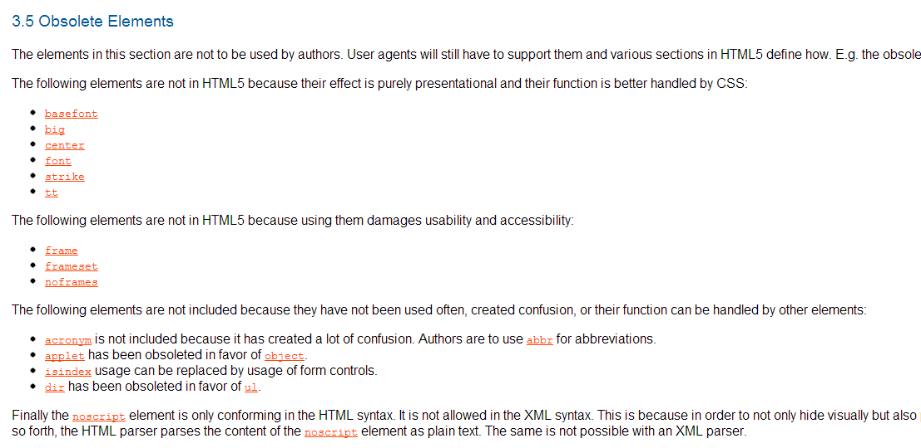

Slide 18
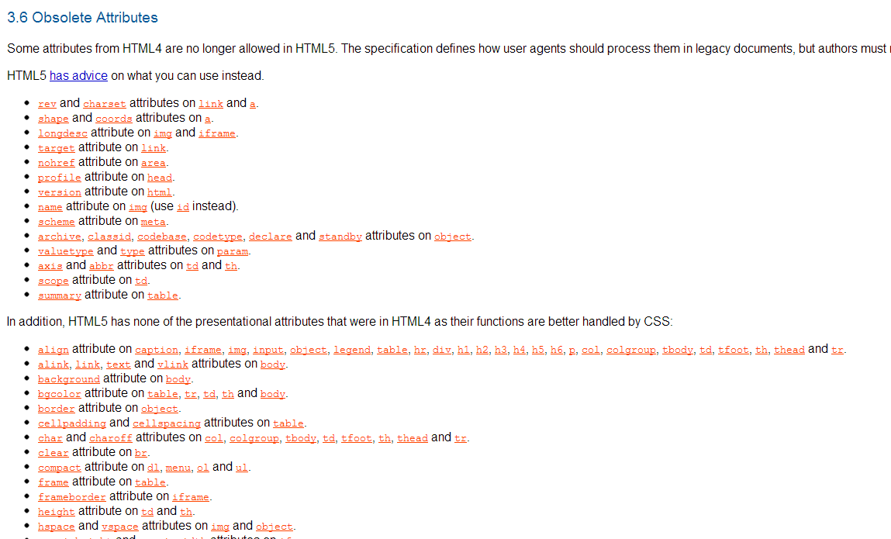

Slide 19
http://www.w3.org/TR/html5-diff/#absent-elements

Slide 20
HTML5
Forms

Slide 21


Slide 22
Attribute: required
Finally
Opt-in feature
Ignored if the browser doesn’t support it
<input type="text" required="required" />
<input type="text" required />

Slide 23
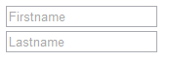

Attribute: placeholder
Only in input fields
Only text, no images
Opt-in feature
<input type="text" name="firstName" placeholder="Firstname" />

Slide 24
Attribute: Pattern
Regular expression to validate the input
Opt-in feature
<input type="text" pattern="[a-z]"
title="text only containing letters"/>

Slide 25
Attribute: autofocus
First come, first serve
<input id="firstName" autofocus />

Slide 26

Attribute list
Autocomplete
<input type="text" list="countries" />
<datalist id="countries">
<option value="BE">Belgium</option>
<option value="UK">United Kingdom</option>
<option value="IS">Iceland</option>
</datalist>

Slide 27
Input fields
<input type="email" />
<input type="url" />
<input type="tel" />
<input type="color" />
<input type="date" />
<input type="time" />
<input type="month" />
<input type="week" />
<input type="datetime" />
<input type="range" />
<input type="number" />

Slide 28
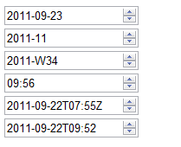
More input fields
<input type="date" />
<input type="month" />
<input type="week" />
<input type="time" />
<input type="datetime" />
<input type="datetime-local" />

Slide 29
HTML5
Audio and Video

Slide 30

We already looking at videos for more then 10 years

Slide 32
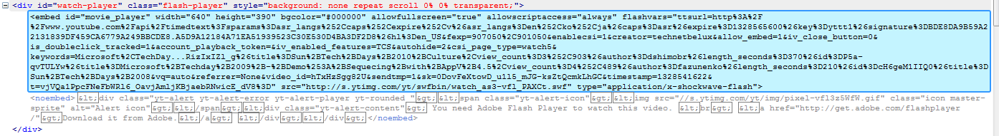

Slide 33
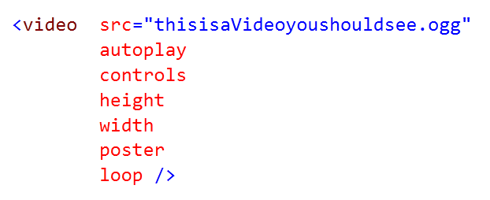

Slide 34
Audio == Video – width – height - poster

Slide 35


Slide 36
What W3C suggested
All browsers should at least have built-in support for
Ogg Vorbis for audio and Ogg Theora for movies

Slide 37
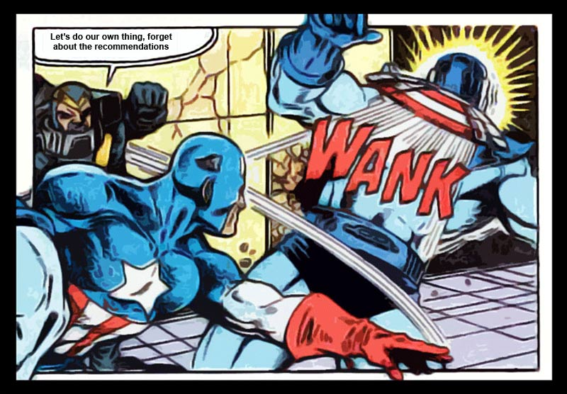

Slide 38
There is NO specification

Slide 39
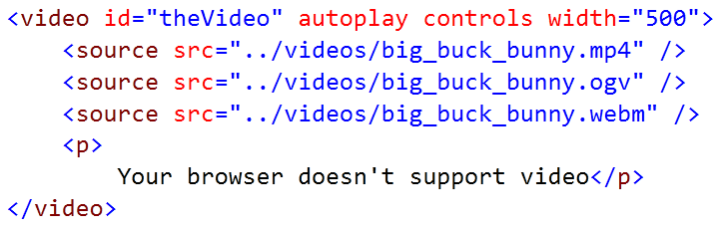

Slide 40
HTML5
Canvas

Slide 41


Slide 42
Canvas
Bitmapped area
Code via JavaScript
Page has to be loaded
Canvas vs Flash, Silverlight or SVG
No extra installation
Works in immediate mode instead of retained mode
Retained: via a graphical renderer
Immediate: direct acces to your objects

Slide 43
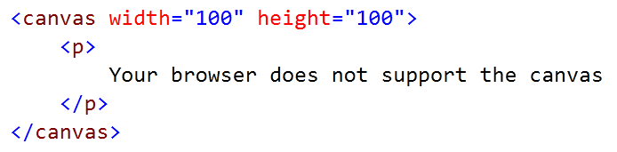

Slide 44


Slide 45
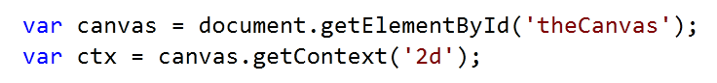
Grab the context

Slide 46
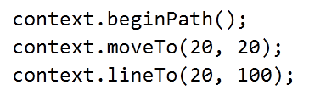

Slide 47
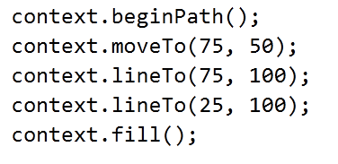

Slide 48

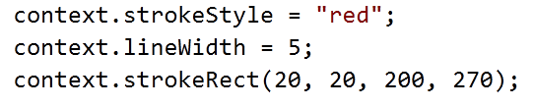

Slide 49
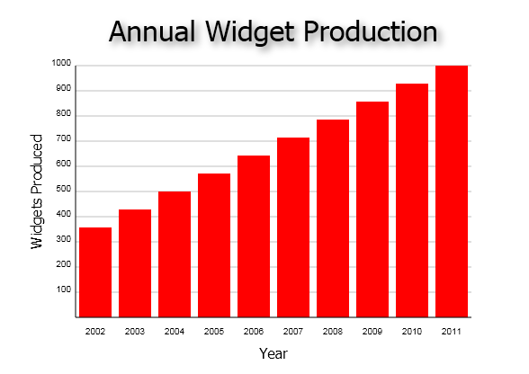

Slide 51
ctx.beginPath();
ctx.moveTo(75, 50);
ctx.lineTo(75, 100);
ctx.lineTo(25, 100);
ctx.fill();

Slide 52

context.beginPath();
context.moveTo(100, 100); context.lineTo(100, 300);
context.lineTo(150, 300);
context.lineTo(150, 155);
context.lineTo(205, 155);
context.lineTo(205, 100);
context.closePath(); context.fillStyle = "#0099ff"; context.fill(); context.lineWidth = 6; context.lineJoin = "round"; context.strokeStyle = "#cccccc"; context.stroke();

Slide 53

context.beginPath(); context.arc(100, 50, 30, 0, Math.PI * 2, true);
context.fill();

